Slide 1
Session 4
NAD1001: INTRODUCTION TO ARCHITECTURAL DESIGN

Slide 3
Introduction to Architectural Design Concept
An architectural design concept is a foundational idea that guides the overall design process of a building or an architectural project. It represents the core principles that shape the approach to the building's design, including its function, form, and interactions with its surroundings. This concept typically manifests through a theme, a central idea, or a metaphor that directs all design decisions, aiming to create a coherent and functional aesthetic and practical output.
The underlaying idea that guides the project.

Slide 4
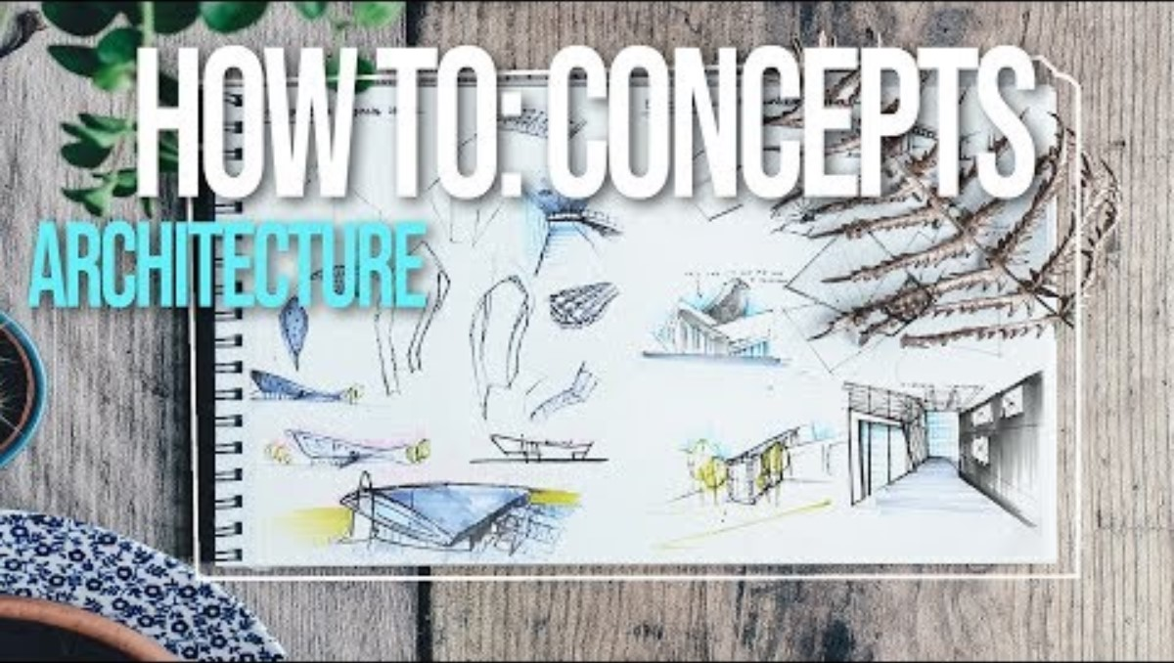
Developing a Design Concept

Slide 5
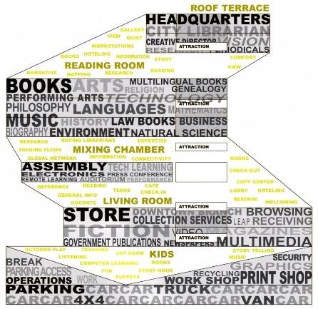
Elements of Design Concept
Form
Space
Function
Aesthetics
And many more inspirations…
Refer to the Seattle Library concept diagram by OMA to see how a concept is developed to a building … which type of concept do you think it is?
Source: OMA

Slide 6
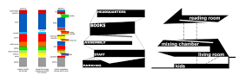
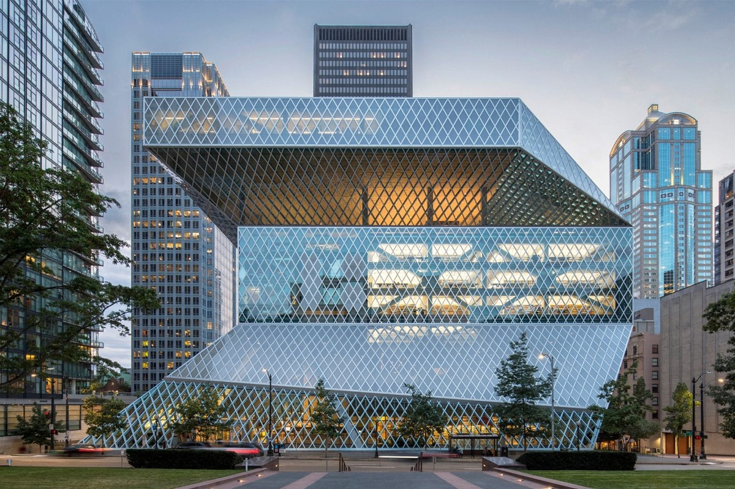
Examples of Architectural Design Concepts
Function as a key concept - OMA Seattle Library
Source: OMA

Slide 7
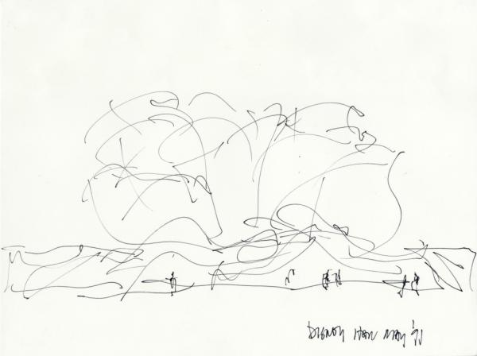
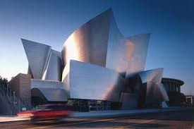
Examples of Architectural Design Concepts
Form as a key concept - Frank Gehry Walt Disney Concert Hall
Source: ArchDaily

Slide 8
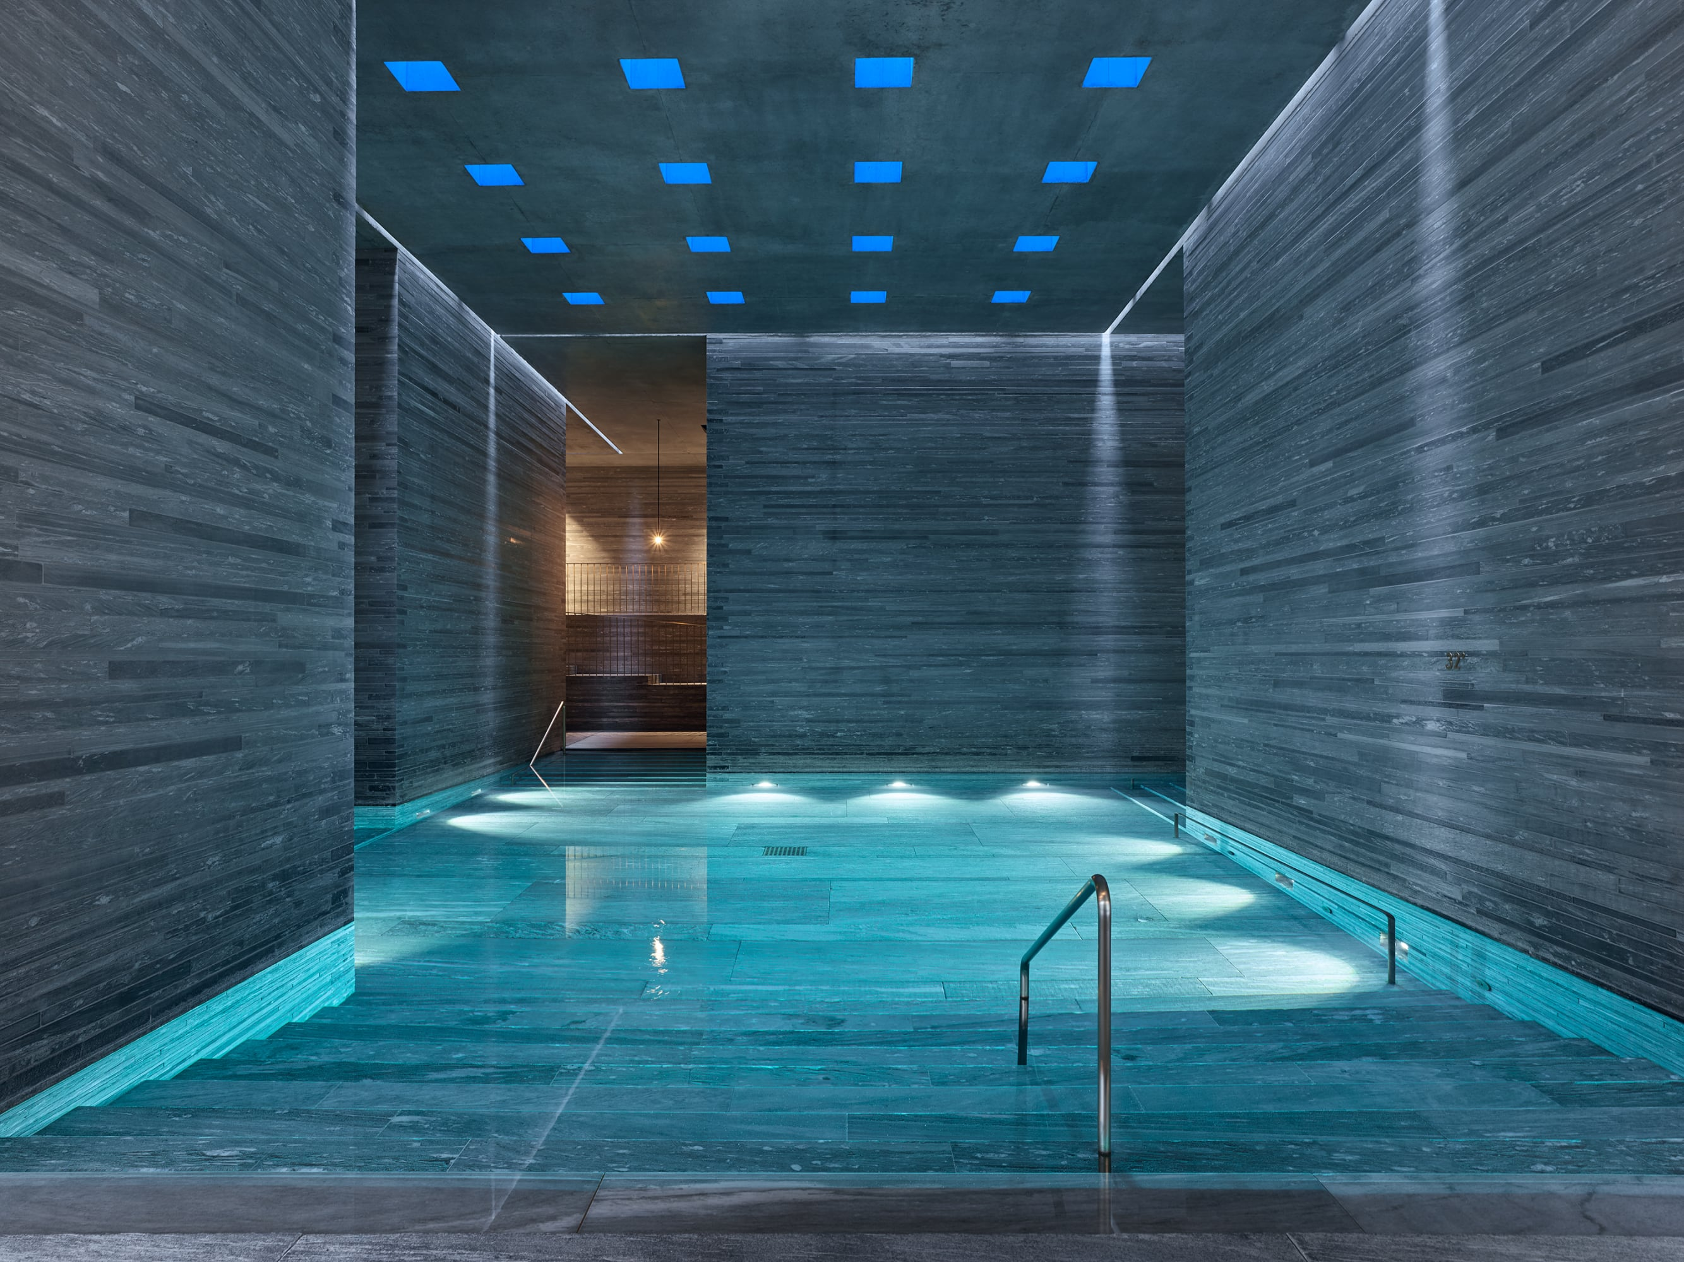
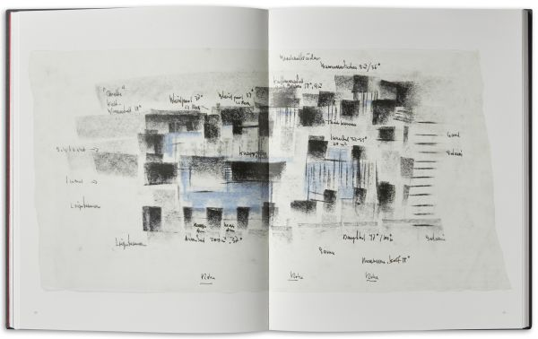
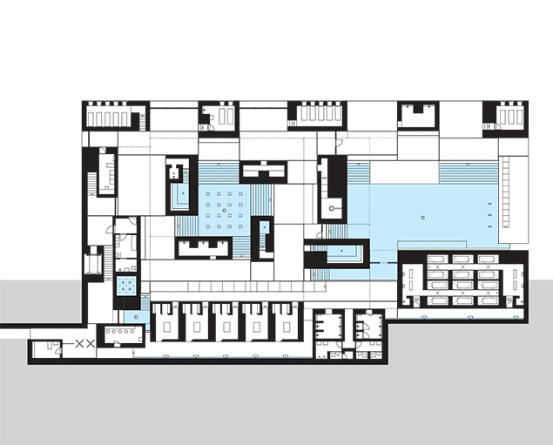
Examples of Architectural Design Concepts
Space as a key concept – Peter Zumthor Thermal Vals
Source: ArchDaily

Slide 9
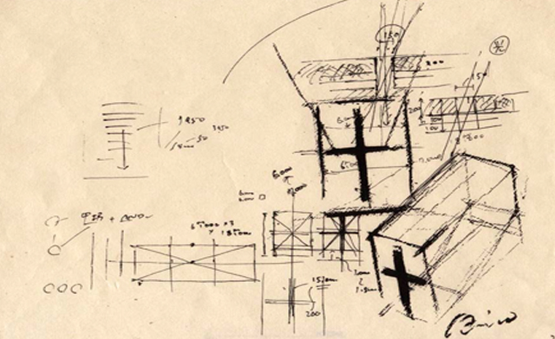
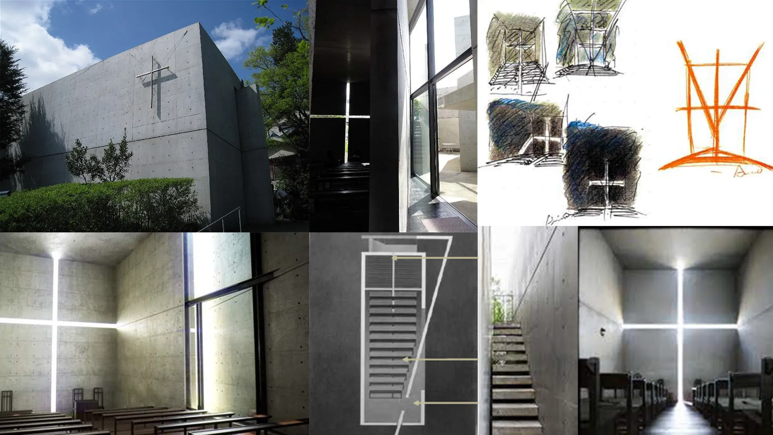
Examples of Architectural Design Concepts
Aesthetics/Symbolism as a key concept Tadao Ando Church of Light
Source: ArchDaily

Slide 10
Manifesto in Architecture
Concept V.S. Manifesto
Scope and Application: Concepts are applied to individual projects and are essential for practical design development. Manifestos have a broader cultural or theoretical scope and aim to influence the field of architecture at large.
Content: Concepts deal with practical and aesthetic considerations specific to a project, whereas manifestos address broader philosophical or ethical issues.
Impact: While a design concept influences the outcome of a specific architectural project, a manifesto seeks to impact the architectural community and practices globally, often pushing for shifts in approach or thinking.

Slide 11
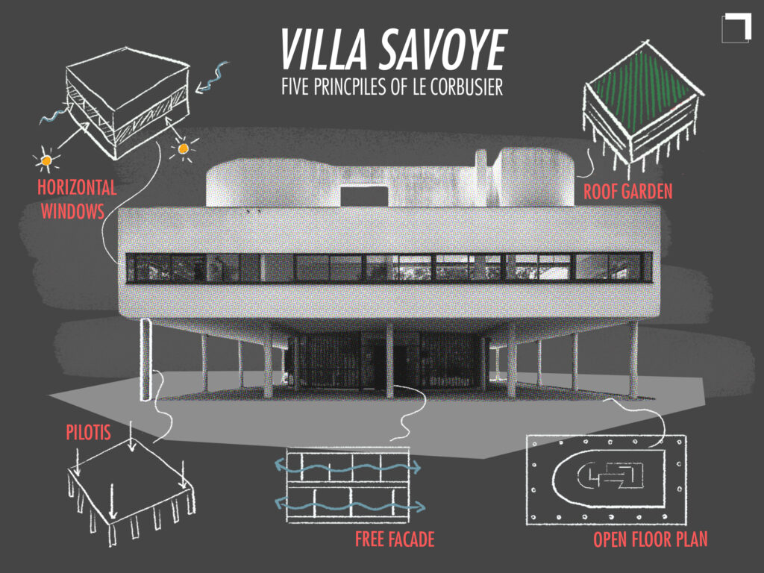
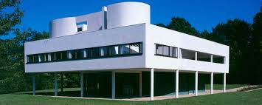
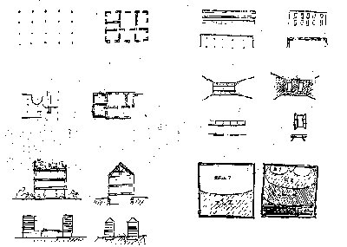
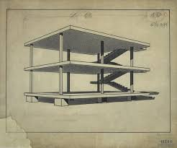
Example Manifesto in Architecture
Author: Le Corbusier
Year : 1926
Summary: Le Corbusier’s “Five Points towards a New Architecture,” 1926 manifesto, advocate for elevating buildings on pilotis (columns) to create open space, employing a free façade through load-bearing columns for design flexibility, adopting open floor plans for adaptability, using continuous ribbon windows for uniform light distribution, and incorporating rooftop gardens for green space and comfort. These principles encapsulate his vision for a modern, functional, and harmonious architectural approach that continues to impact design philosophy.
Source: Pinterest

Slide 12
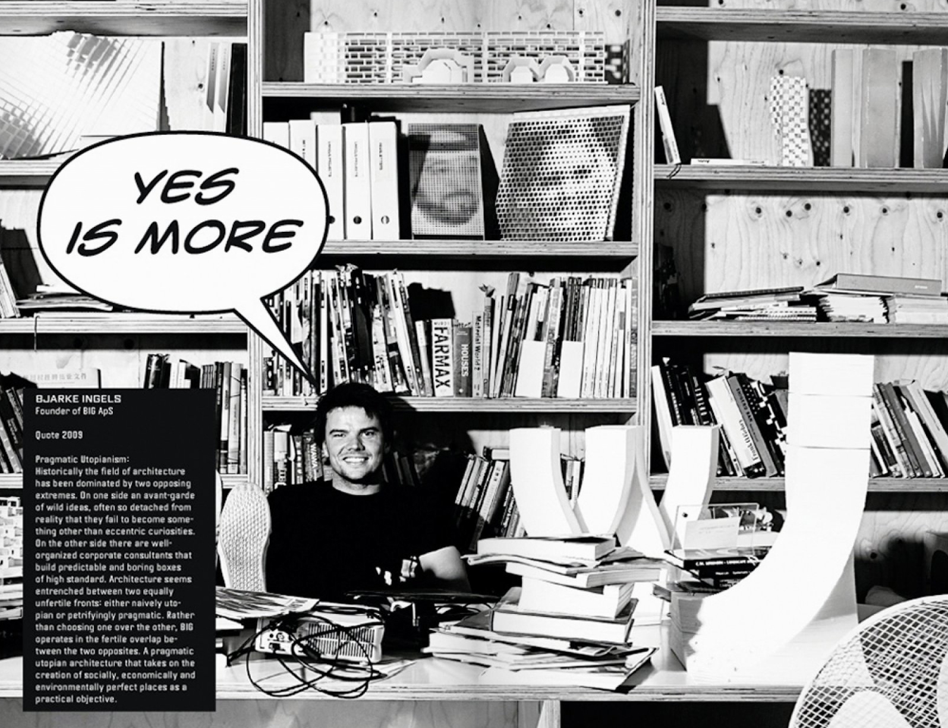
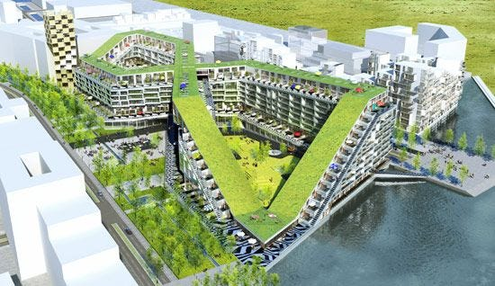
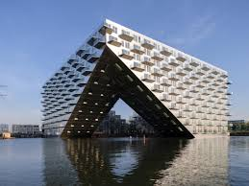
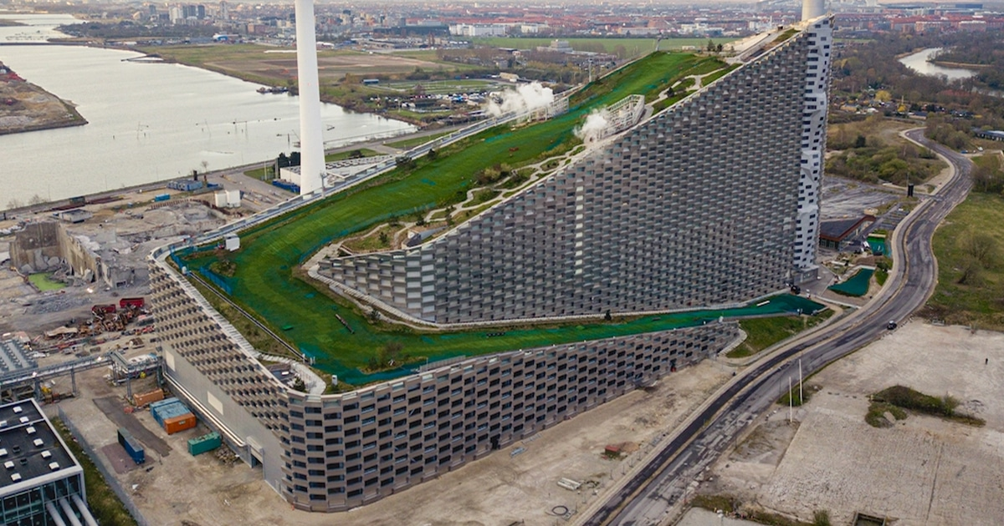
Example Manifesto in Architecture
Author: Bjarke Ingles (BIG)
Summary: One of the most famous expressions of BIG’s architectural philosophy is encapsulated in the "Yes is More" manifesto. This manifesto, which is also the title of a comic book written by Bjarke Ingels, serves as an accessible and dynamic way to present BIG's projects and ideas. It embodies the firm’s approach to architecture and urbanism, focusing on the possibilities rather than the limitations by embracing a can-do spirit.
Inclusivity over Exclusivity
Sustainability as Desirable not as Constraint
Pragmatic Utopian Architecture
Source: ArchDaily

Slide 13
Activity 1: Create a Design Concept

Slide 14
Session 4
Massing

Slide 15
Introduction to Architectural Massing
Definition: Massing refers to the composition of a building’s overall shape and form as defined by its volume and three-dimensional configuration.
Importance: It plays a critical role in defining the aesthetic and functional qualities of a building, influencing both the internal layout and the external appearance.
Usually conducted at the initial Design Phase

Slide 16
Principles of Massing
Key Principles: Scale (the size of building elements in relation to each other), proportion (the relationship between the different parts of the building), and hierarchy (the emphasis placed on certain parts of the building over others).
Zoning and set back are key factors too.
Impact: Proper massing ensures that a building is harmonious with its surroundings and meets the functional needs of its users.

Slide 17
Factors Impacting Massing
Site Constraints: Include limitations and opportunities presented by the site's topography, climate, and existing structures.
Regulatory Factors: Massing must comply with zoning laws, building codes, and other regulatory frameworks that may dictate building height, bulk, and setback.
From Concept to Massing
From Site Analysis to Massing
From Function Arrangement to Massing etc… (refer to the next page for examples of each)

Slide 18
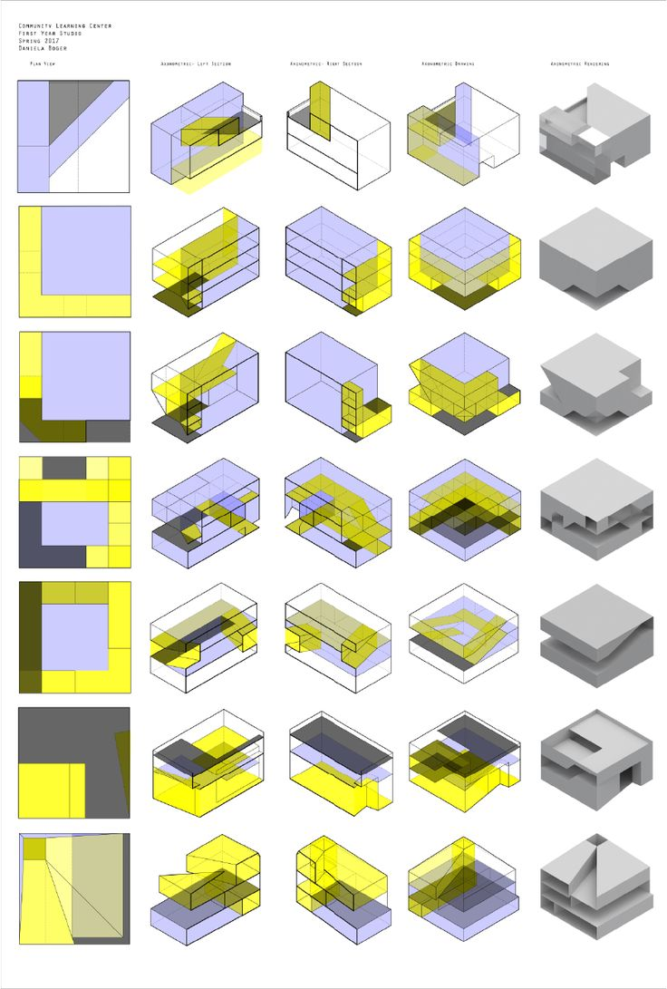
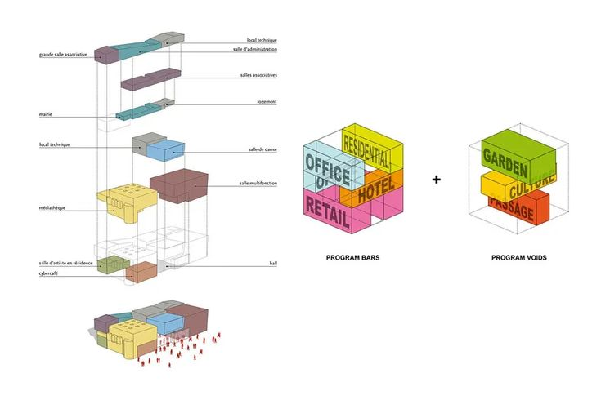
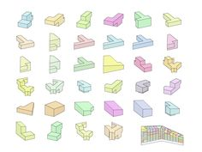
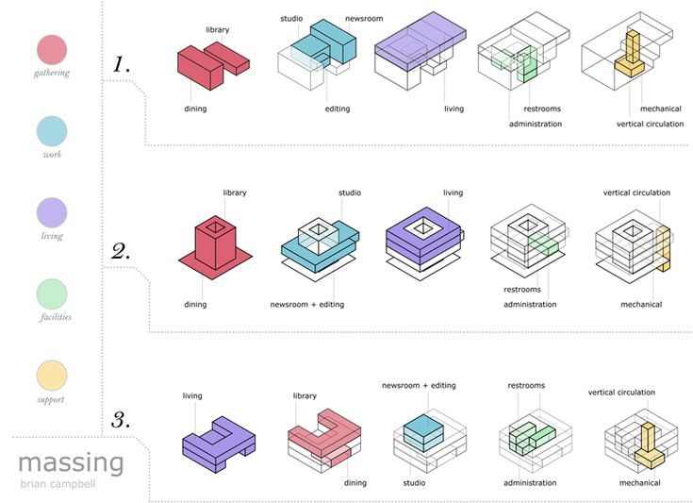
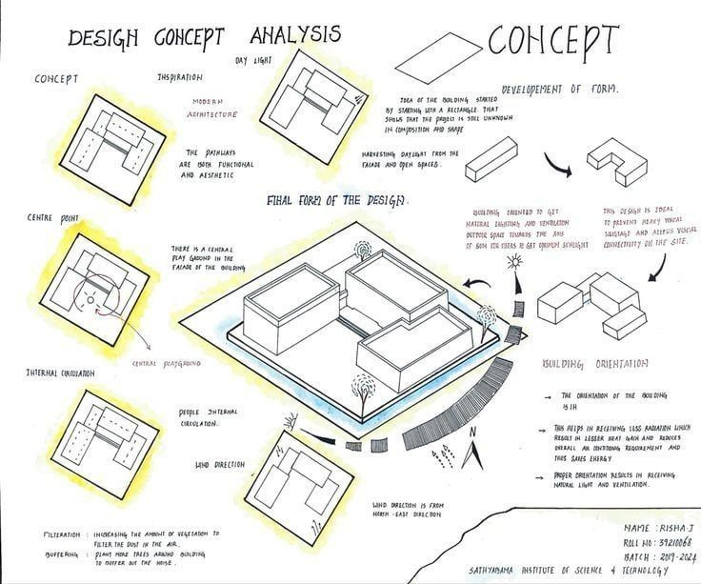
Massing Studies – Digital
Source: Pinterest

Slide 19
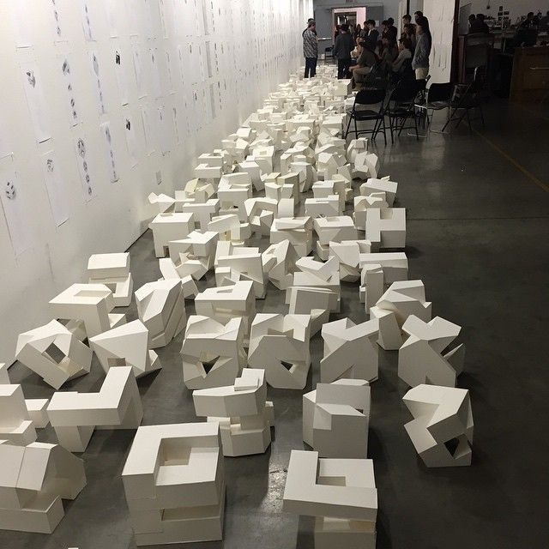
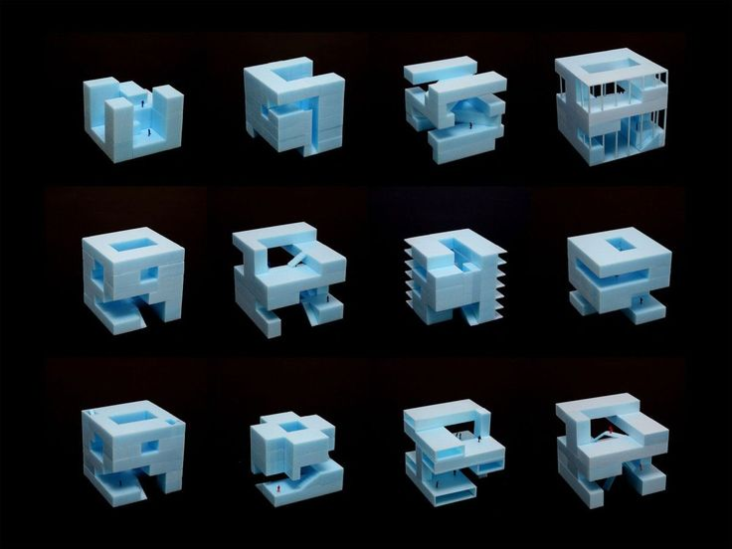
Massing Studies – Modelling
Source: Pinterest

Slide 20
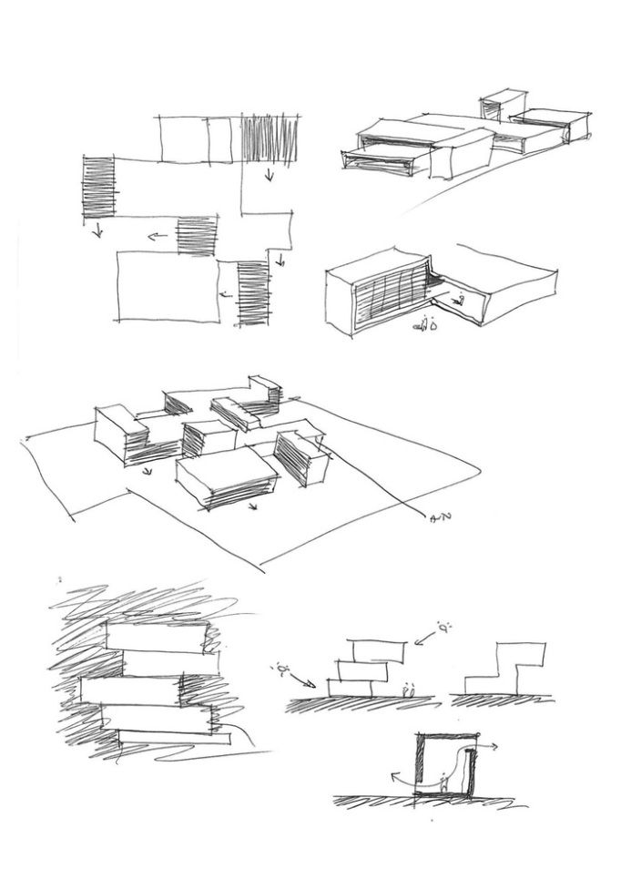
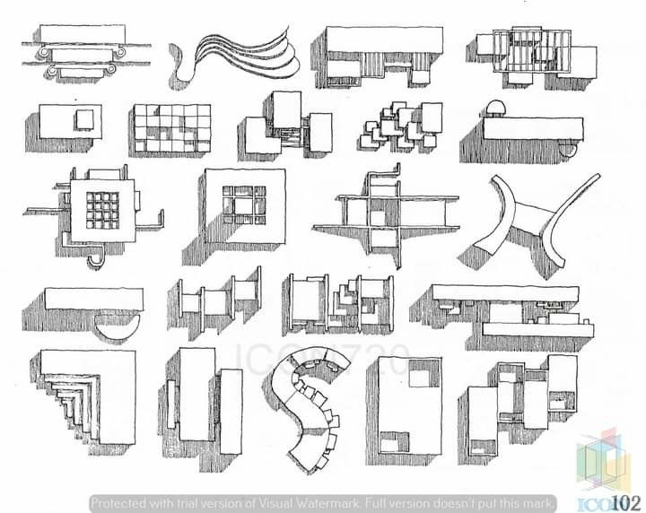
Massing Studies – Sketching
Source: Pinterest

Slide 21
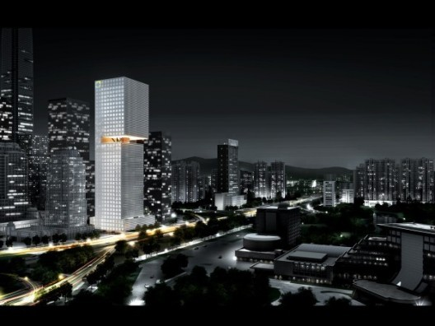

Solid Massing
Source: OMA
OMA's latest competition winner: the Essence Financial Building for the city of Shenzhen, China.

Slide 22
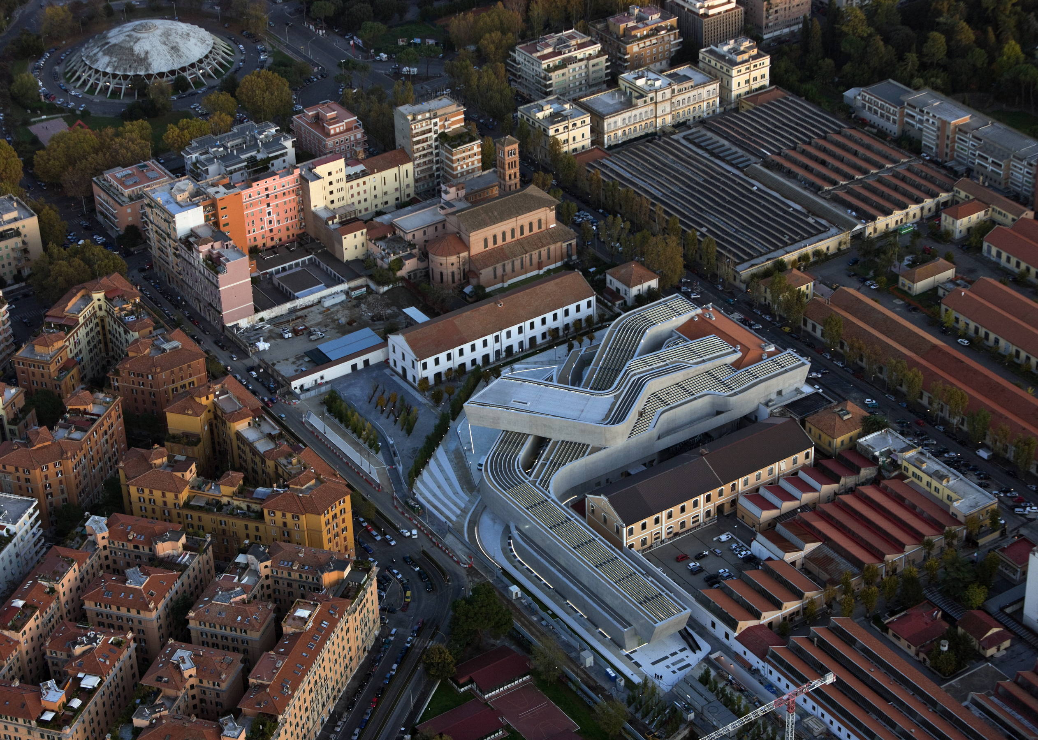
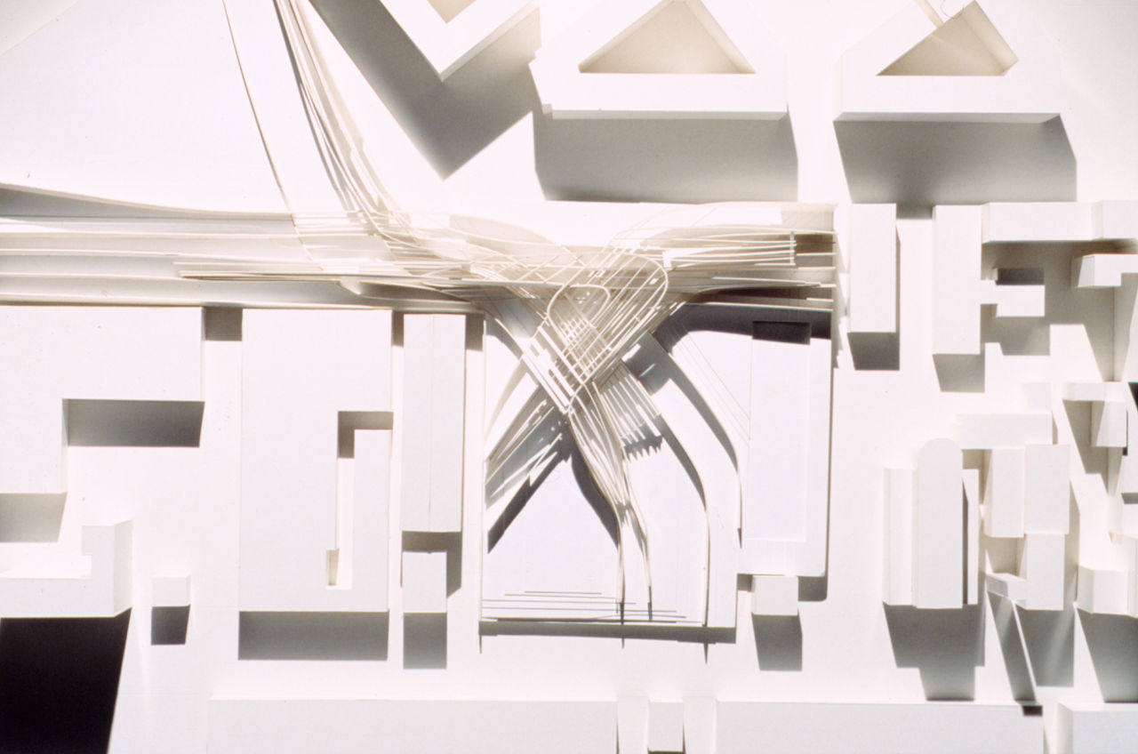
Fluid Massing
Source: Zaha Hadid Architects
Zaha Hadid MAXXI - National Museum of 21st Century Art in Rome, Italy

Slide 23
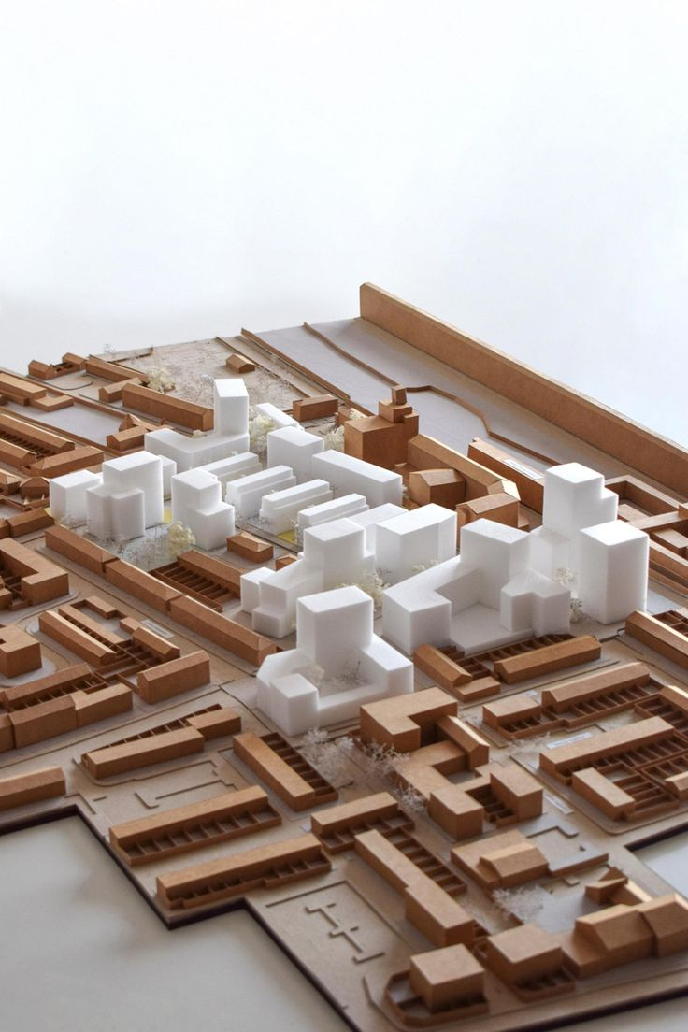
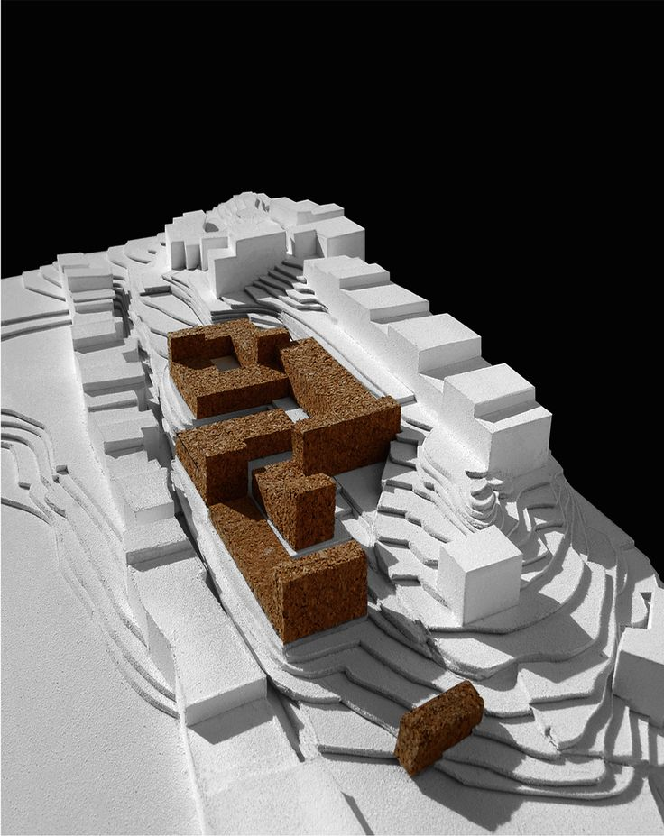
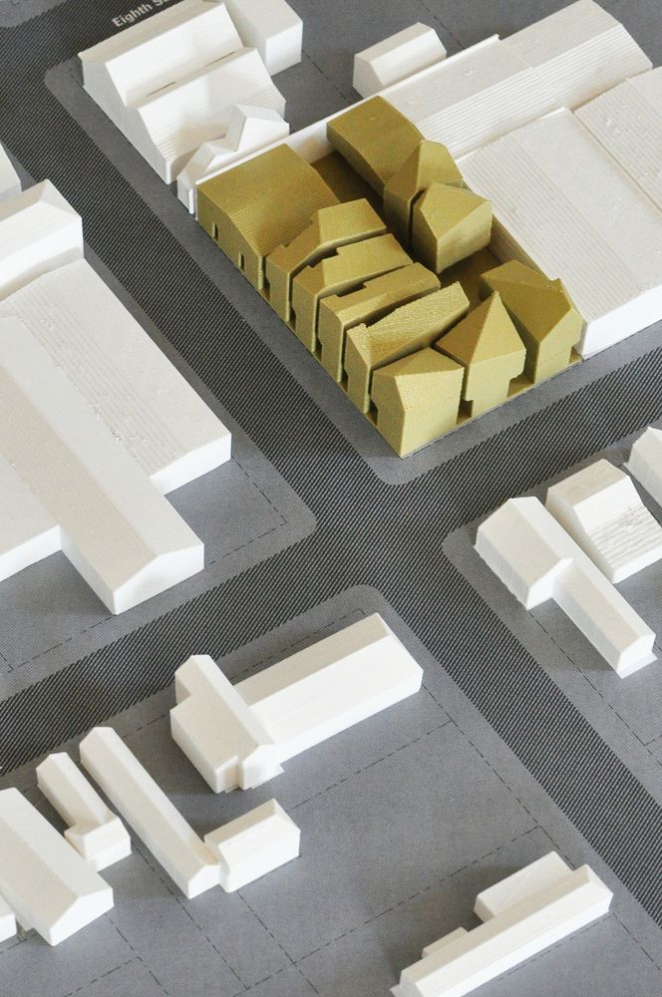
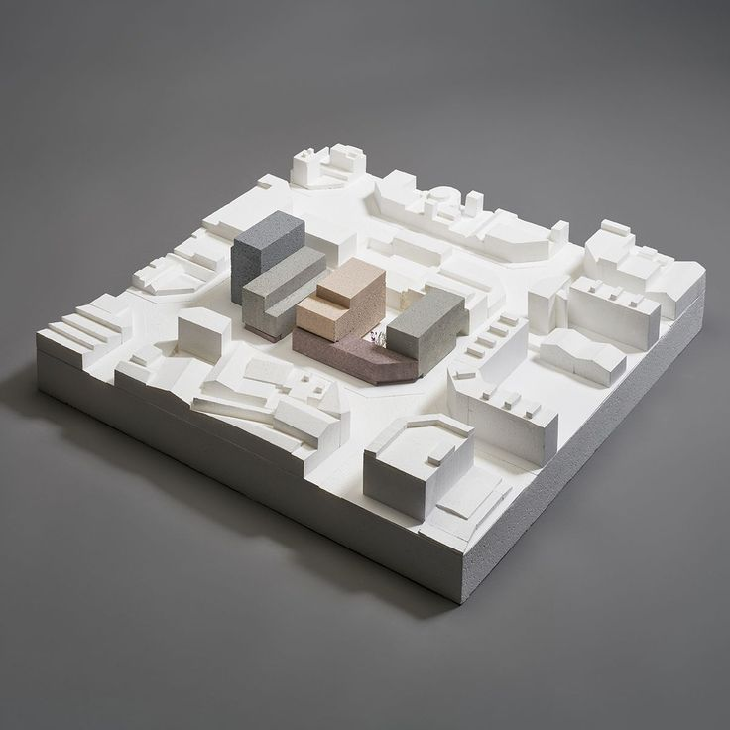
Massing with Site Model
Source: Pinterest

Slide 24
Activity 2: Initial Massing Study

Slide 25
Reference
Zaha Hadid Architects. (2025). Zaha Hadid Archives. https://www.zaha-hadid.com/archive/?type=architecture
OMA. (2025). OMA Projects. https://www.oma.com/projects
Pinterest. (2025). Pinterest Image. https://www.pinterest.com/

Slide 26
Thank you
Questions?

